Slide 1
Web Scraping WhaleWisdom
NYCDSA Web Scraping Project
Jose Gonzalez

Slide 2
Is there correlation between institutional investor behavior and stock returns in Anaplan (NYSE:PLAN)?
WhaleWisdom is a website that aggregates 13F filing data from institutional investment firms (quarterly stock holdings)
Potentially interested parties
Other investors looking to increase returns based on competition behavior
Purpose of the project
Understand if web scraping 13F data is useful for stock investors
Questions
Does institutional buying correlate with positive returns?
Does institutional selling correlate with negative returns?
Is the type of shareholder/institution important to the shareholder base?
What type of institutions help predict returns or are useful to invest alongside for certain styles (ex. VCs for long-term investors)

Slide 3
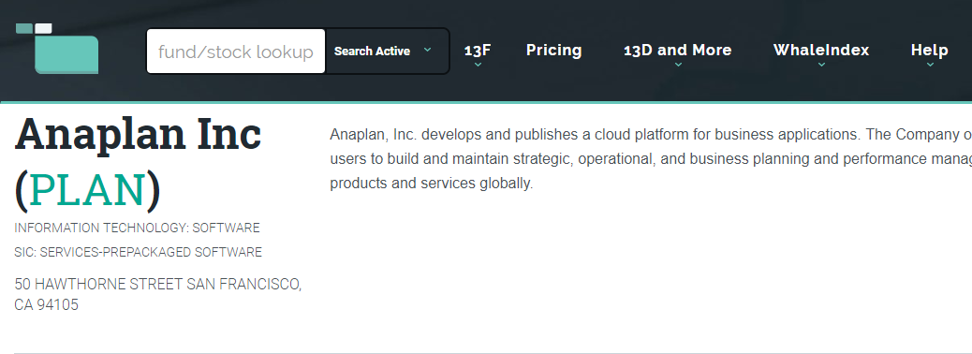
Web Scraping WhaleWisdom with Selenium
Obtaining the XPATH from the first row in the tables and creating a loop that iterates over every row.
Creating a function that clicks the next button to help scrape all the subsequent pages and each row from the table.

Slide 4
Problems Encountered
Besides the data outputting to the csv file being unreadable and/or corrupted, there were several other problems
I had to manually scroll and tried to put it into my code to automate the scrolling but it didn’t improve the scraping
The data was in a table and I tried to scrape the entire table which wouldn’t allow me to loop/iterate, row output was also unreadable even when put into a loop or iterated

Slide 5
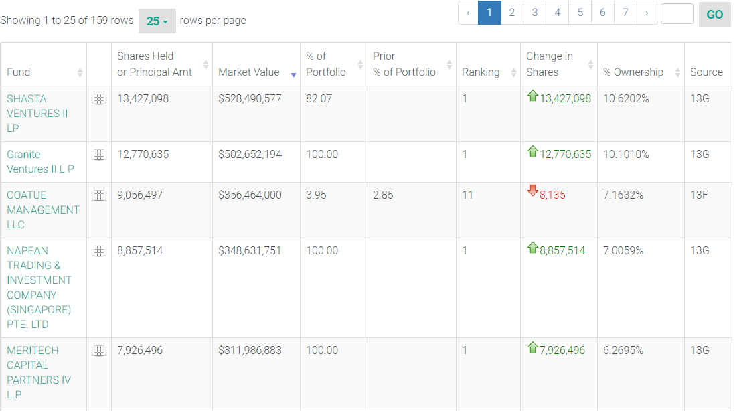
158 filers were included in this dataset, including institutions ranging from large asset managers of ETF indexes and mutual funds, venture capital firms, even large corporations like Salesforce
The highest concentration on a portfolio level seems to be from venture capital firms like Shasta Ventures, other VC firms, and hedge funds like Coatue Management

Slide 6
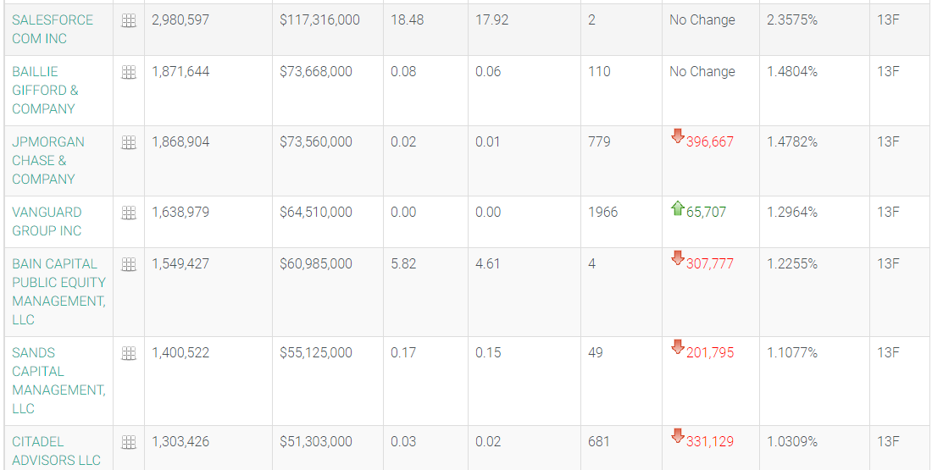
Other Types of Institutional Shareholders

Slide 7
If I was able to scrape the data
I would have created visualizations of the types of firms that were involved as shareholders of Anaplan.
I would have tried to come up with the profile of the “average” Anaplan shareholder.
I would have tried to see if institutional buying or selling correlated with positive or negative stock returns.
I would have also tried to understand when selling was for economic and non-economic reasons, as I think that would be a huge confounding factor in the dataset that would obscure a lot of the potential insights

Slide 8
Future Work
If things were working properly, I would like to extend this work to be able to look at other 13F filing data on lots of other companies and for lots of other shareholders.
There could be identifiable trends that have predictive power in the case of future stock returns, although this may already be arbitraged away.
It would be interesting to test a lot of quantitative factors against the types of institutional buyers and see if you could create a profile of different types of investment firms based on factor style.
Try to see if there is a correlation between institutional buying/selling and future returns. Split these results into groups by type of investment firm to investigate further.

Slide 9
Conclusion
Since I could not accurately scrape data from the website into a csv file, I was unable to perform a proper data analysis.
Even from just glancing at the dataset there were a lot of interesting questions that could have been attempted to be answered.
There is definitely a use for other investors to mine this type of data to try to understand things like sentiment and shareholder base, and it is potentially correlated with securities prices.

